Slide 1
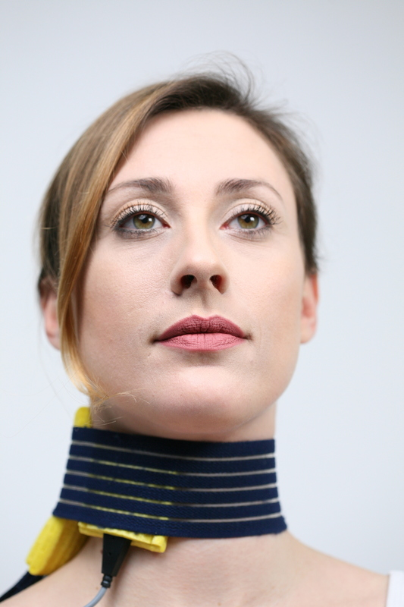
vocaSTIM®-Master
NEW in 2021
Treatment of paresis-related swallowing and voice disorders

Slide 2
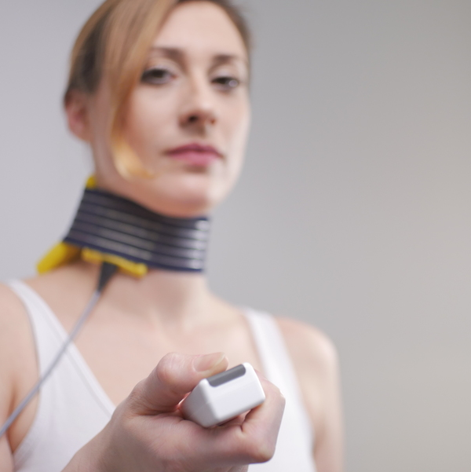
Electrical impulses support swallowing
vocaSTIM® therapy supports the muscles responsible for swallowing and voice formation with electrical impulses that are sensed according to natural stimulus patterns. The patient or the therapist triggers these impulses by means of a hand switch exactly when the patient needs this support in swallowing.

Slide 3
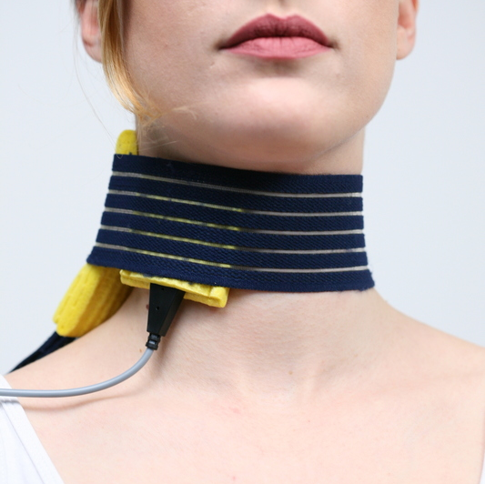
Electrical impulses activate muscles
Particularly in the case of damaged nerve tracts, electrical impulses make it possible to start the phoniatric exercises, because only through electrical innervation of the laryngeal muscles can the patient perform the vocal exercises. Also, through repeated practice, vocaSTIM® therapy prevents a decline of the musculature in these disorders. Without vocaSTIM® therapy, the muscles would be inactive if the nerve pathways were damaged, and this inactivity could lead to irreversible regression of the muscles after a certain degree of damage.

Slide 4
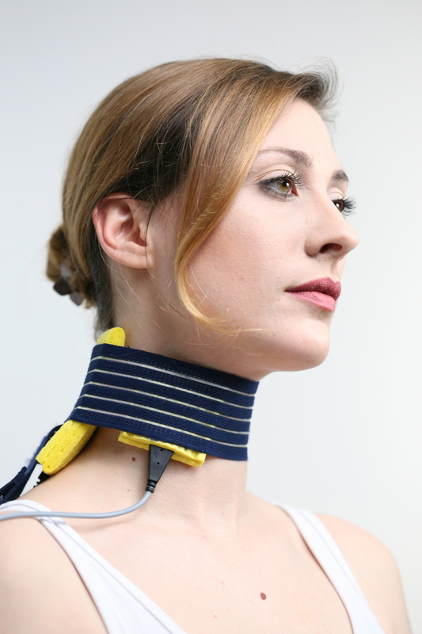
Independent speech exercises
Thanks to the sound and speech exercises adapted to the clinical picture, the patient can perform the electrostimulation independently after instruction by the doctor or therapist. Adjustments to the intensity of the exercises, the tempo and the current degree of damage increase the success of regeneration in the case of disorders.

Slide 5
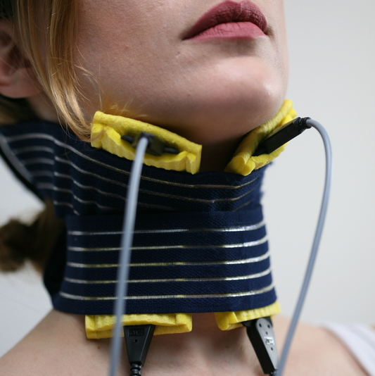
Diagnostics and therapy
The doctor can determine the degree of damage with the help of a diagnostic programme. A foot switch helps to operate the device even if both hands are needed for the laryngoscopy. If the laryngoscopy is not possible due to time constraints, the experienced doctor can classify the degree of damage himself. The tested value is automatically transferred to the indication menu which displays the corresponding therapy settings, electrode placement and exercises.

Slide 6
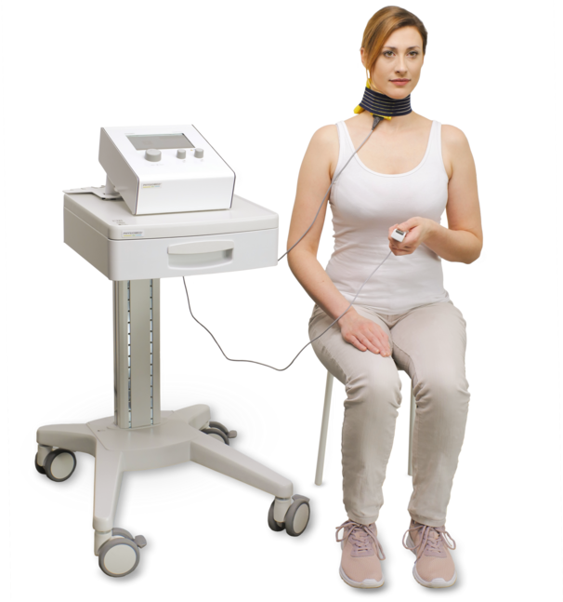
vocaSTIM® - Features
Dual-channel technology for time-delayed innervation of different nerves or muscles
Diagnosis menu
Indication menu with 3D graphics for electrode placement
Foot switch for easier operation of the device during diagnosis
Memory and favourites menu
Audio player with voice and sound exercises integrated in the device
Therapy exercises adapted to the disorder pattern
*Trolley optional

Slide 7
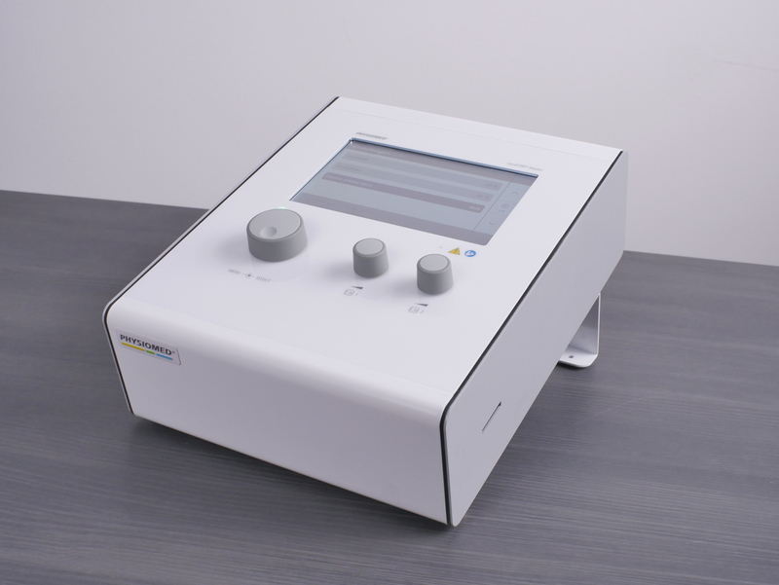
Indications and clinical application
Besides other indications, the vocaSTIM®-Master includes a concept for diagnosis, therapy and therapy progress control for laryngeal paresis [MD4]. After anamnesis, diagnosis and briefing by the doctor or therapist, the patient can normally continue the therapy or voice training independently. A follow-up check is carried out at regular intervals by the accompanying therapist. The standardized therapy or neuromuscular electrophonatory stimulation (NMEPS) is based on electrostimulation of the damaged muscles and nerves in the form of intention exercises. While the patient is trying to trigger an arbitrary contraction (phonation exercise from a CD), supporting current pulse is triggered manually with a button. The stimulation current parameters are determined initially and in the course of the therapy by means of an easy-to-carry out diagnosis and are precisely matched to the indication and the degree of damage [MD4].

Slide 8
Clinical benefits
Laryngeal paresis is peripheral paralysis or partial paralysis of muscles relevant to the voice [MD4]. It leads to disturbance in the voice or even an complete loss of voice and often to impaired respiratory function. Laryngeal paresis can arise as a result of goiter surgery and operations on the head and neck (cervical spine), be caused by numerous other indications, or be of idiopathic origin. In addition to treatment of laryngeal paresis, vocaSTIM® may also be used for swallowing difficulties (dysphargia) and dysarthric disorders with peripheral paresis of the cranial nerves V, VII, IX, X, XI and XII of intentional exercises with articulatory exercises [MD4].
The ability to swallow may be hindered, for example, after a stroke. Restoring the ability to swallow is of the utmost importance for Patients´ health and quality of life.

Slide 9
Technical Data
General Technical Data
Protection class acc. to IEC 60601-1/ VDE 750 Part 1 | I, Type: BF
CE characterization | according to Council Directive concerning medical devices (93/42 EEC)
Protection class acc. Council Directive concerning medical devices (93/42 EEC) | IIa
Mains connection | 100 - 240 VAC ± 10%
Power line frequency | 50 - 60 Hz
Power line input | 120 VA
Current consumption | 0,6 A / 1,2 A
Output Data – Stimulation Current (max.) | G = 5 mA TENS, UR, IG30, IG50, FM, FaS, T/R, T/R sync and T/R alt = 15 mA AMF, MT and KOTS = 20 mA
Line fuses for 100 - 240 VAC: | T2AL, 250 V
Dimensions (W x H x D) | 31.5 x 17.5 x 37.0 cm
Weight | 6.5 kg

